Slide 1
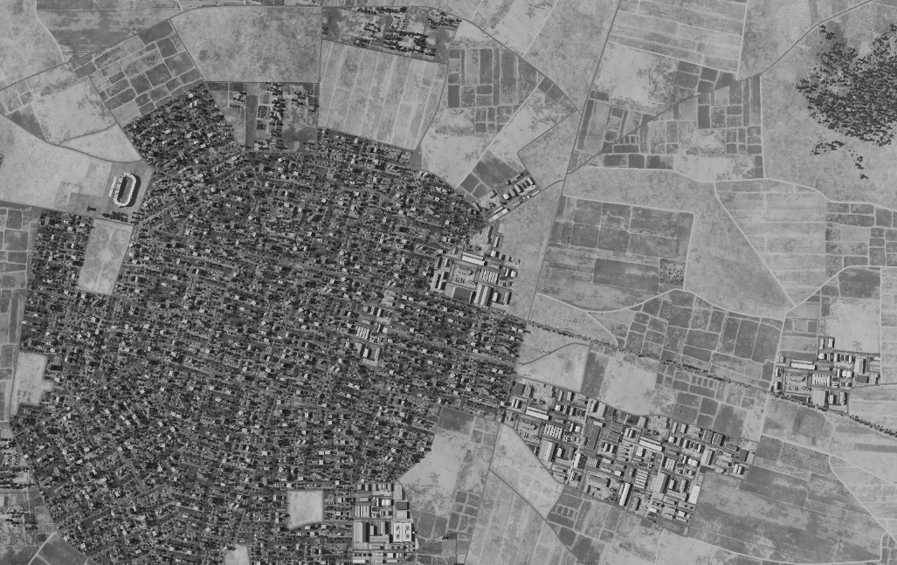
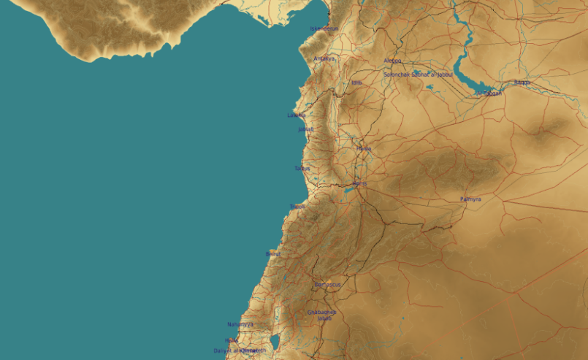
SYTGT116 Idlib Food storage
SYTGT116
N
116
Target complex consist of six storage buildings.
VID assess no organic self-defense at this location, however defenses of Idlib is likely present from Syrian army units.
Civilian industrial buildings in immediate vicinity.

Slide 2
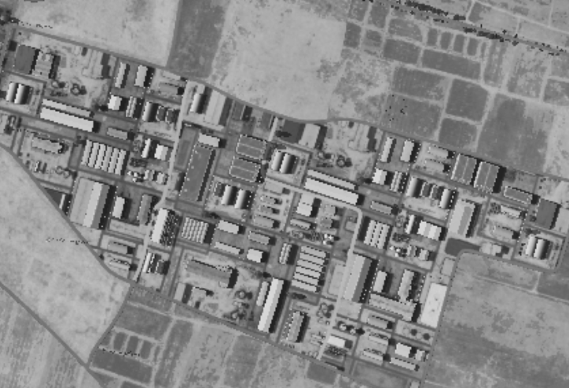
SYTGT116 Idlib Food storage
SYTGT116
N
116
SYTGT116A – Production Building
N35 55.455 E036 39.306/1288ft / (1x2000 Ibs bomb)
SYTGT116B – Production Building
N35 55.447 E036 39.302/1289ft / (1x2000 Ibs bomb)
SYTGT116C – Production Building
N35 55.439 E036 39.300/ 1290ft / (1x2000 Ibs bomb)
SYTGT116D – Production Building
N35 55.431 E036 39.298/1291ft / (1x2000 Ibs bomb)
SYTGT116E – Production Building
N35 55.423 E036 39.294/1292ft / (1x2000 Ibs bomb)
SYTGT116F – Production Building
N35 55.414 E036 39.290/1294ft / (1x2000 Ibs bomb)
B
A
D
C
E
F
Civilian industrial buildings in immediate vicinity.

